Slide 1
Community Structure
Bisection Method, Louvain Algorithm
MA 653: Network Science
Instructor: Ashok Singh Sairam
ashok@iitg.ac.in

Slide 2
Division into more than two groups
In the case of community detection, we cannot simply continue dividing the output pairs of the community detection algorithms for two communities
The modularity of the complete network does not break up into independent contributions from the separate communities
We must explicitly consider the change ΔQ in the modularity of the entire network upon further bisecting a group g of size n_{g}

Slide 3
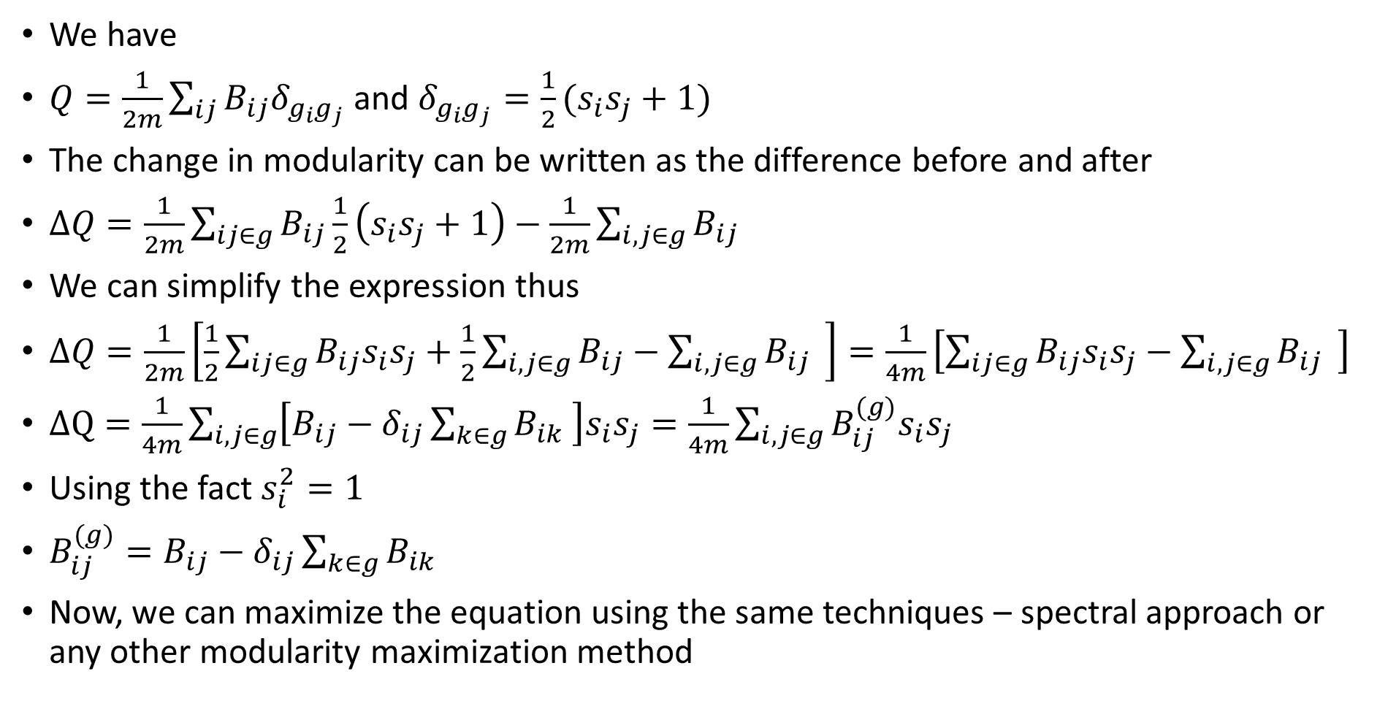
We have
$Q=\frac{1}{2m}\sum_{ij}{B_{ij}δ_{g_{i}g_{j}}}$ and $δ_{g_{i}g_{j}}=\frac{1}{2}(s_{i}s_{j}+1)$
The change in modularity can be written as the difference before and after
$ΔQ=\frac{1}{2m}\sum_{ij∈g}{B_{ij}\frac{1}{2}\left(s_{i}s_{j}+1\right)−\frac{1}{2m}\sum_{i,j∈g}{B_{ij}} }$
We can simplify the expression thus
$ΔQ=\frac{1}{2m}\left[\frac{1}{2}\sum_{ij∈g}{B_{ij}s_{i}s_{j}+\frac{1}{2}\sum_{i,j∈g}{B_{ij}}−\sum_{i,j∈g}{B_{ij}} }\right]=\frac{1}{4m}\left[\sum_{ij∈g}{B_{ij}s_{i}s_{j}−\sum_{i,j∈g}{B_{ij}} }\right]$
$ΔQ=\frac{1}{4m}\sum_{i,j∈g}{\left[B_{ij}−δ_{ij}\sum_{k∈g}{B_{ik}} \right]s_{i}s_{j}}=\frac{1}{4m}\sum_{i,j∈g}{B_{ij}^{(g)}s_{i}s_{j}}$
Using the fact $s_{i}^{2}=1$
$B_{ij}^{(g)}=B_{ij}−δ_{ij}\sum_{k∈g}{B_{ik}}$
Now, we can maximize the equation using the same techniques – spectral approach or any other modularity maximization method

Slide 4
Division into more than two groups
The above problem has the same format as the spectral modularity maximization
Hence, we find the leading eigenvector of B^{(c)} and divide the network according to the signs of its elements
When do we stop this iterative process?
If we are unable to find any division of a community that results in a positive change ΔQ in the modularity, we leave that community undivided
The leading eigenvector will have all elements with the same sign
When we have subdivided the network to the point where all communities are in this indivisible state, the algorithm terminates

Slide 5
Summary of Repeated Bisection method
Start with a single division into two groups
Repeatedly subdivide each group again and again as many times as necessary
Repeat the process, as long as Q increases

Slide 6
The repeated bisection is by no means perfect
There is no guarantee that the best division of a network into three parts can be found by first finding the best division into two parts and then subdividing one of two
As we have mentioned, we can even attempt to find the maximum modularity over divisions directly into any number of groups
This can, in principle, find better divisions
More complicated and slower

Slide 7
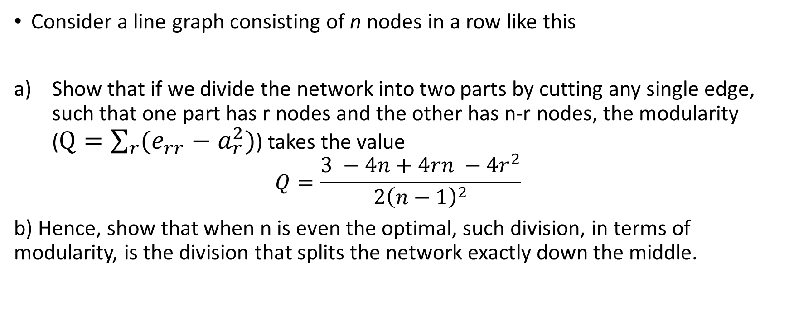
Ex: 14.1
Consider a line graph consisting of n nodes in a row like this
Show that if we divide the network into two parts by cutting any single edge, such that one part has r nodes and the other has n-r nodes, the modularity ($Q=\sum_{r}{(e_{rr}−a_{r}^{2})}$) takes the value
$$Q=\frac{3 −4n+4rn −4r^{2}}{2{\left(n−1\right)}^{2}}$$
b) Hence, show that when n is even the optimal, such division, in terms of modularity, is the division that splits the network exactly down the middle.

Slide 8
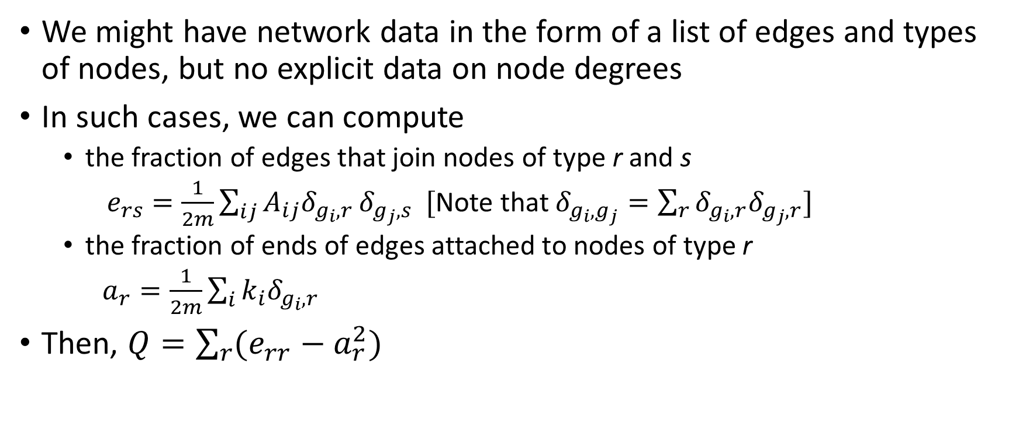
Alternative form of Modularity
We might have network data in the form of a list of edges and types of nodes, but no explicit data on node degrees
In such cases, we can compute
the fraction of edges that join nodes of type r and s
$e_{rs}=\frac{1}{2m}\sum_{ij}{A_{ij}δ_{g_{i},r}}δ_{g_{j},s} [$Note that $δ_{g_{i},g_{j}}=\sum_{r}{δ_{g_{i},r}δ_{g_{j},r}}]$
the fraction of ends of edges attached to nodes of type r
$a_{r}=\frac{1}{2m}\sum_{i}{k_{i}δ_{g_{i},r}}$
Then, $Q=\sum_{r}{(e_{rr}−a_{r}^{2})}$

